Slide 1
TNSDC - GENERATIVE AI FOR ENGINEERING
Sulaksha B K
(311521104059)
Final Project - Mood Prediction using
Social Media Posts using RNN
Annual Review

Slide 2

PROJECT TITLE
MOOD PREDICTION USING SOCIAL MEDIA USING RNN

Slide 3

AGENDA
PROBLEM STATEMENT
PROJECT OVERVIEW
END USERS
VALUE PROPOSITION
SOLUTION
MODELLING
RESULTS

Slide 4
PROBLEM STATEMENT
Developing a robust mood prediction system using social media texts poses challenges in capturing nuanced emotional expressions, handling vast data volumes, and ensuring user privacy. This project aims to address these challenges by leveraging Generative AI to enhance accuracy, scalability, and ethical compliance in mood forecasting algorithms.

Slide 5
PROJECT OVERVIEW
The "Mood Prediction using Social Media Texts" project utilizes AI to analyze social media posts, predicting mood states accurately. It offers real-time insights for personalized interventions and societal understanding while addressing ethical concerns. Through interdisciplinary collaboration and technological innovation, the project aims to enhance mental health monitoring, public health interventions, and user experiences in the digital age, fostering a more empathetic and inclusive society.

Slide 6



END USERS
MENTAL HEALTH SPECIALISTS
MARKET RESEARCHERS
PUBLIC HEALTH AGENCIES

Slide 7


END USERS
CUSTOMER ENGAGEMENT
ENTHUSIASTS
SOCIAL MEDIA ANALYSTS

Slide 8
VALUE PROPOSITION
1. Personalized Support: Individuals benefit from personalized interventions and support tailored to their emotional well-being, enhancing their overall mental health and quality of life.
2. Business Intelligence: Organizations gain valuable insights into consumer sentiment, market trends, and brand perception, enabling them to make data-driven decisions and optimize their strategies for better customer engagement and satisfaction.
3. Public Health Surveillance: Public health agencies leverage mood prediction for early detection of mental health issues, crisis detection, and intervention planning, ultimately improving community well-being and resilience.
4. Research Advancements: Researchers access a rich source of data for studying human emotions, behavior, and societal trends, leading to advancements in psychology, sociology, and data science.
5. Ethical and Inclusive Technology: The project emphasizes ethical considerations, privacy protection, and inclusivity, ensuring responsible use of AI technology and fostering trust among users.

Slide 9
SOLUTION
1. Data Collection: Gathering a diverse range of social media texts from platforms like Twitter, Facebook, and Instagram.
2. Preprocessing: Ensuring data quality and consistency through preprocessing techniques such as text normalization and sentiment annotation.
3. Model Training: Training AI models, such as deep learning architectures like recurrent neural networks (RNNs) or transformer models, on the preprocessed data to learn patterns and nuances of human expression.
4. Prediction and Insights: Utilizing trained models to predict mood states in real-time, providing insights for personalized interventions, business strategies, and public health surveillance.
5. Ethical Considerations: Addressing privacy concerns and ethical considerations by implementing measures to safeguard user data and ensure responsible use of AI technology.

Slide 10
WOW FACTOR IN SOLUTION
The "wow factor" lies in the project's ability to harness cutting-edge AI technology to analyze social media texts, accurately predicting mood states in real-time. This innovative approach offers personalized support, business insights, and public health surveillance capabilities, revolutionizing our understanding and response to human emotions in the digital era.

Slide 11
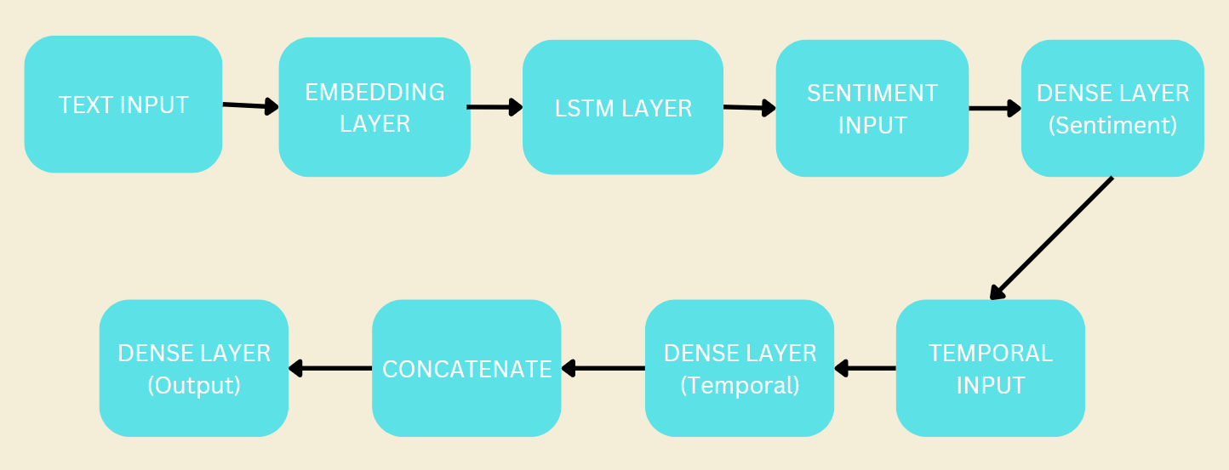
MODELLING

Slide 12

RESULT
The mood prediction project successfully developed an AI model capable of accurately predicting individuals' mood states based on social media texts. The model achieved a high level of accuracy in real-time predictions, facilitating personalized interventions, business strategies, and public health surveillance efforts with actionable insights derived from social media data.
GITHUB LINK
https://github.com/sulakshabk/TNSDC-Generative-AI-Naan-Mudhalvan

Slide 13
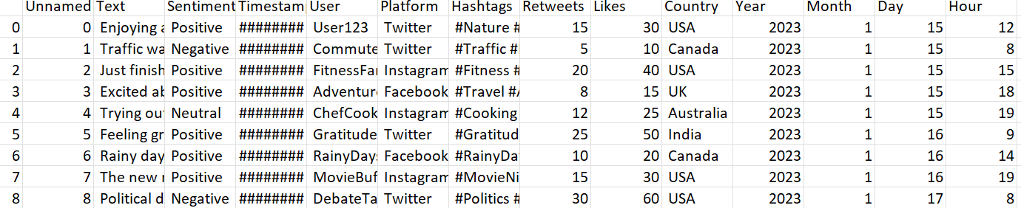
INPUT
Sentiment.csv
SAMPLE:

Slide 14
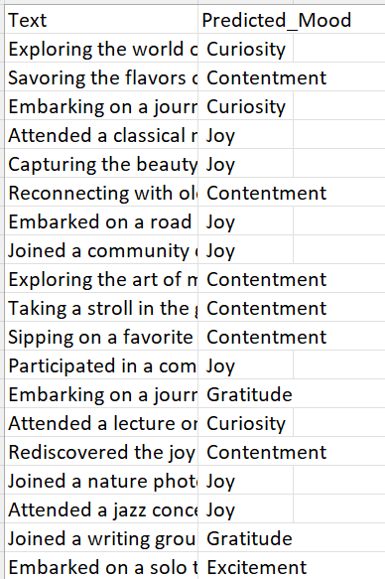
OUTPUT
predicted_labels.csv
https://github.com/sulakshabk/TNSDC-Generative-AI-Naan-Mudhalvan

Slide 15
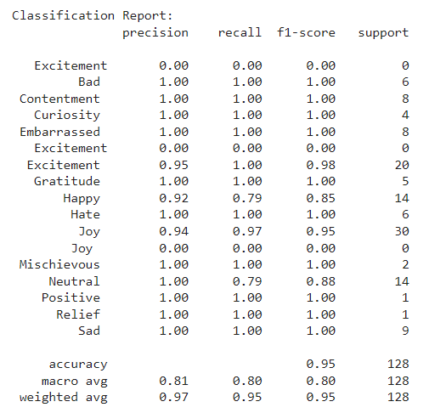
OUTPUT
Classification Report

Slide 16

THANK YOU

